Slide 1

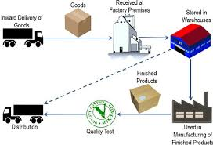

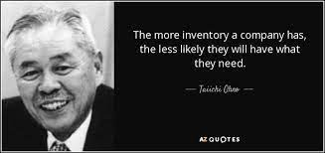
Strategic Sourcing & Inventory Management
Notes:
Let me take this opportunity to thank the Principal Dr.Umrani Sir, Vice Principal Dr.Ghongte Patil Sir, Dr.Wankhate Sir, Sushmita Nande madam, Snehal Choukate madam, and other honorable members of Garware College of Commerce, for giving me this opportunity to share my views on the said topics of and Strategic Sourcing & Inventory management in supply chain.
I also wish to thank all the students who have joined for this session. Let me update you that all of you present here on the board as well few students who are yet to join all are lucky enough because you already have been imparted knowledge from the expert faculty from the college, and now I wish to add upon the briefing u the topic of Inventory management from the industry perspective, which will enable u or help u to make the concepts which u already have learnt become more clear. Learning from the your professors and gaining insights from the people like me about the industry will make your process of learning more meaningful and purposeful. I specially thank Garware college for engaging people like me representing industry which itself is a very unique way of imparting knowledge along with referring the books together.
So today I will start my session, and I shall be sharing two different topics of Strategic Sourcing & Inventory management in supply chain etc.
Here my way of delivering the session and sharing with u the concepts will be little different, in two ways - - First whenever I will share with you about a particular concept I will try to explain with a example from the industry perspective so that you all slowly and gradually will get acquainted or made aware as to what exactly these concepts mean in practical sense in the industry which otherwise u will learn from the books. And the second way is you all will continuously be questioned and I shall ask every body a question which u need to answer, which you all shall try to attempt. The sole purpose of mine is to make the sessions more interactive and most importantly more enjoyable.

Slide 2
Acquirement's?
Need and Essentials of Material Control.
Functions of the Purchase Department.
Purchase Procedure.
Purchase Documentation.
Methods of Inventory control--i. Stock Levels.ii. Economic Order Quantity (EOQ). iii. ABC analysis iv. Perpetual and Periodic Inventory Control v. Physical verification
Inventory Turnover Ratio
Notes:
Acquirements उपार्जन is something which we wish to acquire, something we wish to gain, or obtain. कुछ हम हासिल करना चाहते हैं या प्राप्त करना चाहते हैं
Now let us see what we want to acquire from this session or what you will be gaining from today’s session? Or the learning outcomes?
Topics to be covered
Need and Essentials of Material Control.
Functions of the Purchase Department.
Purchase Procedure.
Purchase Documentation.
Methods of Inventory control--i. Stock Levels.ii. Economic Order Quantity (EOQ). iii. ABC analysis iv. Perpetual and Periodic Inventory Control v. Physical verification
Inventory Turnover Ratio

Slide 3
Strategic Sourcing & Purchasing/Procurement
Notes:
Sourcing vs. Procurement: How are They Different?
Now that we broke down procurement and sourcing processes let’s look closely at the differences between these two.
Process Components
Since sourcing is a subset of procurement, sourcing is a less complex process with fewer components. It comprises defining internal requirements, searching for vendors, arranging sourcing events, and assessing suppliers.
On the other hand, procurement encompasses the sourcing process itself, purchasing (placing of purchase orders, receiving of the order, and making payments), data analysis, contract and supplier relationship management
Timing
Sourcing takes place mainly before the purchase is made. However, the sourcing team can also step in during the purchasing process if suppliers can’t fulfill their responsibilities in compliance with a contract.
Besides, at the end of the procurement process, it is a sourcing task to judge the suppliers’ performance and decide whether to continue the relationship.
Unlike sourcing, procurement is an end-to-end process covering all the activities before, during, and after the purchase.
Goals and Focus
Sourcing is a strategic process with long-term goals such as creating relationships with the most suitable suppliers and building and maintaining a resilient supply chain.
The procurement process, on the contrary, combines strategic (sourcing and supplier relationship management) and tactical (purchasing) components.
It mainly concerns itself with buying high-quality goods and services for the lowest price and satisfying internal requirements.
Simply put, sourcing focuses on who provides the commodities, while procurement — on what and how has to be purchased.
Function
Sourcing supports procurement by building supply chains and systems for procurement professionals to use.
Sourcing specialists develop vendor relations, while the procurement team leverages these relationships to obtain desired products.
Thus, sourcing makes the flow of supplies possible, whereas procurement aims at streamlining and optimizing this flow.
Besides, the sourcing team agrees on the pricing and quantity of the product with suppliers.
Then, the procurement department uses that information to forecast the spend and determine how much budget to allocate for buying a certain quantity of goods.
To sum up, sourcing develops a foundation for procurement to fulfill its aim.
Procurement provides information for sourcing.
Just as procurement is impossible without sourcing, sourcing can’t function correctly without data from procurement specialists.
Procurement managers gather information on supplier performance during the purchasing process, and the sourcing team uses it to evaluate vendors and either continue working with them or terminate the contract.

Slide 4
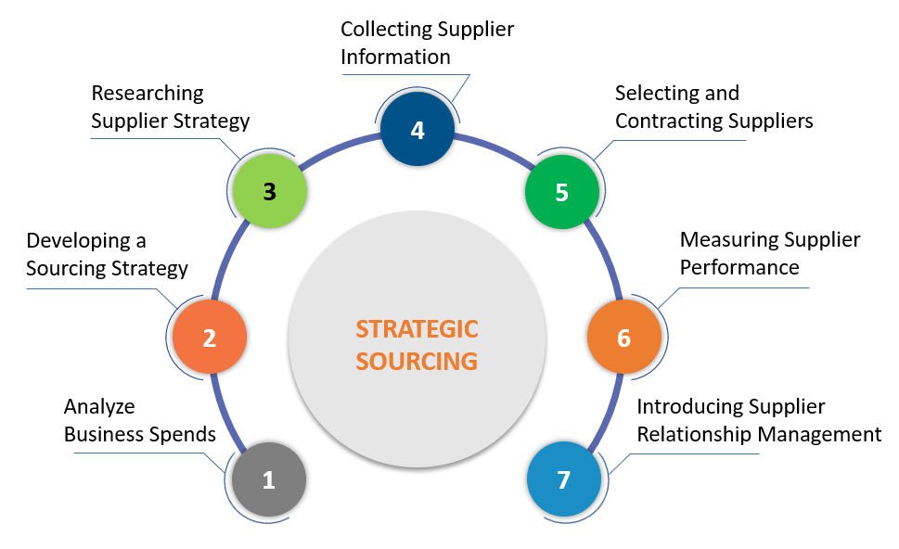
Strategic Sourcing & Inventory Management
Notes:
7 Steps to Create an Effective Sourcing Strategy
Given the benefits of strategic sourcing, it would be tempting to implement a sourcing strategy for your organization at the earliest. However, it follows a systematic 7-step plan, which flows as follows:
Analyzing Business Spends
The first stage of strategic sourcing process-building pertains to identifying the key spend areas prevailing across the organization and categorizing them into critical/non-critical, domestic/international, direct/indirect spendings, etc. By using these categories, businesses can carry out risk analysis and prioritize the sourcing activities to develop the sourcing strategy.
Ask questions about
Product– what are the products we wish to buy, what are its applications in the final products,
Price– price in the market?, any substitute product available?,
Qty’s – how much to buy, when, do we have any timeliness?
Supplier’s – who are we buying from? Capacity, capability, technical competency, financial capability?, Does he have the technical and competent team members to handle our production and quality requirement’s?
Delivery performance– Suppliers delivery performance? Timely delivery, Quality, Qty fulfilment?
Developing a Sourcing Strategy
Now that you have all your spending categorized and prioritized, you can map the corresponding business requirements that necessitate the spending, timelines for fulfilling these requirements, and the communication workflow for keeping all stakeholders on the same page. This document acts as your backbone and blueprint for the sourcing process and strategy.
Researching the Supplier Market
After carrying out all the homework internally, it is time to step out and analyze the market. Take stock of the current and future suppliers and record their profiles. Get an in-depth understanding of their market standing, historical industrial performance, revenue or market share, and any other risks or opportunities.
Collecting Supplier Information
To support the information collected in the previous stage, you will need complete supplier information. For this purpose, you can request for RFQs/RFIs/RFPs from suppliers. Ensure that you explicitly state your business requirements so that suppliers can submit accurate information relating to it. Collect and collate this data in a master list so that all the information is readily available.
Selecting and Contracting Suppliers
By now, your business must already have a few selection parameters to select the ideal supplier. Apply those as filters to shortlist the prospective suppliers from your master list. Ideally, you will want someone delivering high quality and maximum cost savings. When you narrow down on the ideal supplier, initiate the onboarding and contracting process.
Measuring Supplier Performance
Strategic sourcing does not end merely at choosing the supplier. It is a sustained ongoing process that also delves into measuring the supplier performance with respect to the organizational requirements. Identify the areas of improvement and track the supplier performance periodically to locate sourcing risks and potential disruptions.
Introducing Supplier Relationship Management
Finally, having a Supplier Relationship Management (SRM) tool can be highly effective in maintaining cordial and fruitful relations between businesses and suppliers. It opens up a two-way process where both stakeholders benefit from the association. SRM lays the groundwork for collaborative action and adds more value to the otherwise dry customer-buyer relationship.

Slide 5
Types of Materials
DIRECT MATERIAL
All material and components specially purchased or issued from stores for the process and all primary packing materials.
INDIRECT MATERIAL
Consumable stores, lubricating oil, greases, fuel oil, tools, jigs and fixtures, sundry stores of small value like cotton waste broom stick etc.

Slide 6
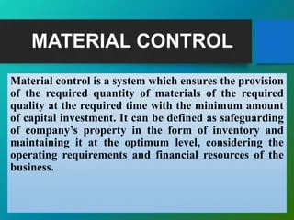
Need of Materials Control
Availability of materials
No excessive investment in materials
Reasonable price
Minimum wastage
Risks of spoilage and obsolescence
Information about availability of materials
Material can be easily misappropriated
Notes:
INTRODUCTION AND MEANING OF MATERIAL CONTROL Material management is a function responsible for-coordination of planning, sourcing, purchasing, moving, storing, and controlling materials. Objective is to minimize the material procurement and stock holding costs. & material cost control to be effective, it involves the cooperation of various departments.
3FEATURES OF MATERIAL CONTROL The quality and specification of materials
Material control aims for Purchasing at minimum price and avoids urgent purchases
Storage of material or running out of stock will be avoided,
Wastage and losses shall be avoided.
Materials are classified and accounted.
4 NEED FOR MATERIAL CONTROL OR OBJECTIVES Availability of materials
No excessive investment in materials
Reasonable price
Minimum wastage
Risks of spoilage and obsolescence
Information about availability of materials
Material can be easily misappropriated

Slide 7
Essentials of Materials Control
Proper cooperation and coordination
Purchases of materials should be centralized
Proper scheduling of materials
Records should be maintained
System of internal check should be introduced
Good method of issue of material should be followed
Storage of material should be well planned
Proper method of inspection should be followed
Ordering quantity of material should be fixed
Minimum maximum and reordering levels of material should be fixed

Slide 8
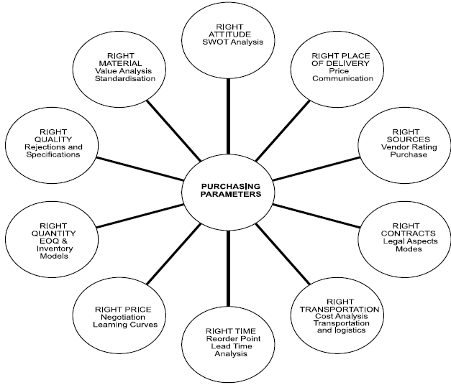
Functions of Purchase Department
Notes:
RIGHT ATTITUDE Developing the right attitude, too, is necessary as one often comes across such statement: ‘Purchasing knows the price of everything and value of nothing’; ‘We buy price and not cost’; ‘When will our order placers become purchase managers?’; ‘Purchasing acts like a post box’. Therefore, purchasing should keep ‘progress’ as its key activity and should be future-oriented. The purchase manager should be innovative and his long-term objective should be to minimize the cost of the ultimate product. He will be able to achieve this if he aims himself with techniques, such as, value analysis, materials intelligence, purchases research, SWOT analysis, purchase budget lead time analysis, etc.
RIGHT CONTRACTS The buyer has to adopt separate policies and procedures for capital and consumer items. He should be able to distinguish between indigenous and international purchasing procedures. He should be aware of the legal and contractual aspects in international practices.
RIGHT MATERIAL Right type of material required for the production is an important parameter in purchasing. Techniques, such as, value analysis will enable the buyer to locate the right material.
RIGHT TRANSPORTATION Right mode of transportation has to be identified as this forms a critical segment in the cost profile of an item. It is an established fact that the cost of the shipping of ore, gravel, sand, etc., is normally more than the cost of the item itself.
RIGHT PLACE OF DELIVERY Specifying the right place of delivery, like head office or works, would often minimize the handling and transportation cost.

Slide 9
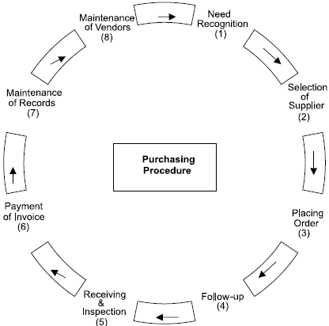
Purchase Procedure
Notes:
RECOGNITION OF THE NEED The initiation of procedure starts with the recognition of the need by the needy section. The demand is lodged with the purchase department in the prescribed Purchase Requisition Form forwarded by the authorized person either directly or through the Stores Department. The purchase requisition clearly specifies the details, such as, specification of materials, quality and quantity, suggested supplier, etc. Generally, the low value sundries and items of common use are purchased for stock while costlier and special items are purchased according the production programmes. Generally, the corporate level executives are authorized signatories to such demands. Such purchases are approved by the Board of Directors. The reference of the approval is made on requisition and a copy of the requisition is sent to the secretary for the purpose of overall planning and budgeting.
THE SELECTION OF THE SUPPLIER The process of selection of supplier involves two basic aspects: searching for all possible sources and short listing out of the identified sources. The complete information about the supplier is available from various sources, such as, trade directories, advertisement in trade journals, direct mailing by the suppliers, interview with suppliers, salesmen, suggestions from business associates, visit to trade fair, participation in industries convention, etc. Identification of more and more sources helps in selecting better and economical supplier. It should be noted that the low bidder is not always the best bidder. When everything except price is equal, the low bidder will be selected. The important considerations in the selection are the price, ability to supply the required quantity, maintenance of quality standards, financial standing etc. It should be noted that it is not necessary to go for this process for all types of purchases. For the repetitive orders and for the purchases of low-value, small lot items, generally the previous suppliers with good records are preferred.
PLACING THE ORDER Once the supplier is selected the next step is to place the purchase order. Purchase order is a letter sent to the supplier asking to supply the said material. At least six copies of purchase order are prepared by the purchase section and each copy is separately signed by the purchase officer. Out these copies, one copy each is sent to store-keeper, supplier, accounts section, inspection department and to the department placing the requisition and one copy is retained by the purchase department for record.
FOLLOW UP OF THE ORDER Follow-up procedure should be employed wherever the costs and risks resulting from the delayed deliveries of materials are greater than the cost of follow-up procedure, the follow-up procedure tries to see that the purchase order is confirmed by the supplier and the delivery is promised. It is also necessary to review the outstanding orders at regular intervals and to communicate with the supplier in case of need. Generally, a routine urge is made to the supplier by sending a printed post card or a circular letter asking him to confirm that the delivery is on the way or will be made as per agreement. In absence of any reply or unsatisfactory reply, the supplier may be contact through personal letter, phone, telegram and/or even personal visit.
RCEIVING AND INSPECTION OF THE MATERIALS The receiving department receives the materials supplied by the vendor. The quantity are verified and tallied with the purchase order. The receipt of the materials is recorded on the specially designed receiving slips or forms which also specify the name of the vendor and the purchase order number. It also records any discrepancy, damaged condition of the consignment or inferiority of the materials. The purchase department is informed immediately about the receipt of the materials. Usually a copy of the receiving slip is sent to the purchase department.
PAYMENT OF THE INVOICE When the goods are received in satisfactory condition, the invoice is checked before it is approved for the payment. The invoice is checked to see that the goods were duly authorized to purchase, they were properly ordered, they are priced as per the agreed terms, the quantity and quality confirm to the order, the calculations are arithmetically correct etc
MINTENANCE OF THE RECORDS Maintenance of the records is an important part and parcel of the efficient purchase function. In the industrial firms, most of the purchases are repeat orders and hence the past records serve as a good guide for the future action. They are very useful for deciding the timings of the purchases and in selecting the best source of the supply.
MAINTENANCE OF VENDO RELATIONS The quantum and frequency of the transactions with the same key suppliers provide a platform for the purchase department to establish and maintain good relations with them. Good relations develop mutual trust and confidence in the course of the time which is beneficial to both the parties. The efficiency of the purchase department can be measured by the amount of the goodwill it has with its suppliers.
Selection of Suppliers Selection of the right supplier is the responsibility of the purchase department. It can contribute substantially to the fundamental objectives of the business enterprise. Different strategies are required for acquiring different types of materials. The selection of supplier for standardized products will differ from non-standardized products. Following factors are considered for the selection of suppliers:
SOURCES OF SUPPLIER The best buying is possible only when the decision maker is familiar with all possible sources of supply and their respective terms and conditions. The purchase department should try to locate the appropriate sources of the supplier of various types of materials. This is known as ‘survey stage’. A survey of the following will help in developing the possible sources of supply:
Specialized trade directories.
Assistance of professional bodies or consultants.
The buyer’s guide or purchase handbook.
The manufacturer’s or distributor’s catalogue.
Advertisements in dailies.
Advertisement in specialized trade journals.
Trade fair exhibitions.
DEVELOPMENT OF APPROVED LIST OF SUPPLIERS The survey stage highlights the existence of the source. A business inquiry is made with the appropriate supplier. It is known as ‘Inquiry Stage’. Here a short listing is made out of the given sources of suppliers in terms of production facilities and capacity, financial standing, product quality, possibility of timely supply, technical competence, manufacturing efficiency, general business policies followed, standing in the industry, competitive attitude, and interest in buying orders etc.
EVALUATION AND SELECTION OF THE SUPPLIER The purchase policy and procedure differ according to the type of items to be purchased. Hence, evolution and selection of the supplier differ accordingly. In the ‘purchasing handbook’ edited by Aljian, it has been described that the following variables to be considered while evaluating the quotations of the suppliers:
Cost Factors Price, transportation cost, installation cost if any, tooling and other operations cost, incidence of sales tax and excise duty, terms of payment and cash discount are considered in cost factor.
Delivery Routing and F.O.B. terms are important in determining the point at which the title to the goods passes from vendor to the buyer and the responsibility for the payment of the payment charges.
Design and Specification Factors Specification compliance, specification deviations, specification advantages, important dimensions and weights are considered in line with the demonstration of sample, experience of other users, after sale services etc.
Legal Factors Legal factors include warranty, cancellation provision, patent protection, public liability, federal laws and reputation compliance.
Vendor Rating The evaluation of supplier or vendor rating provides valuable information which help in improving the quality of the decision. In the vendor rating three basic aspects are considered namely quality, service and price. How much weight should be given to each of these factors is a matter of judgment and is decided according to the specific need of the organization. Quality would be the main consideration in the manufacturing of the electrical equipments while price would be the prime consideration in the product having a tense competitive market and for a company procuring its requirements under the blanket contract with agreed price, the supplier rating would be done on the basis of two variables namely quality and delivery.

Slide 10
Purchase Documentation & its flow
Notes:
What is the procurement process?
Proper procurement procedure consists of six main procurement process steps.
1. Need identification
This process starts when someone submits a request to the purchasing department. The request can be relatively simple (a new software license for the marketing department) or complex (a new office in Guatemala). Whatever it is, the request needs to be submitted in writing and sufficiently detailed.
2. Vendor selection
Next, the procurement department needs to investigate vendors, request quotes for the item needed, and then select a vendor. This is an important part of the process because reputation, cost, speed of service, and dependability all need to be investigated before making a final decision. The rule of thumb is to get at least three quotes, but that’s a best practice that will need to be determined by your organization.
3. Submit purchase requisition
Now it’s time to get approval for the purchase. After you’ve identified the vendor and agreed on the details, you’ll need written approval from the department responsible for approving purchases. You should provide purchasing with the following details:
Party requesting item or service
Quantity and description of item or service required
Vendor’s information
Price
4. Generate purchase order
After the purchase request has been approved, the finance department will issue a purchase order to the vendor. That purchase order signals to the vendor that the purchase request has been approved and that they can proceed with the request.
If your company intends on ordering from this vendor long-term (or if your company relies on a lot of third-party suppliers in general), you may want to develop a supplier onboarding process to ensure both parties understand what's expected.
5. Invoice and order
The vendor will then submit an invoice to the purchaser. The invoice is a request for payment and gives a detailed breakdown of the cost. The invoice will also give a deadline for payment, and you’ll need to submit payment before the deadline or else there may be a penalty (which is usually detailed in the invoice, as well).
The vendor will also send over an order, which is another detailed description of the goods or services requested. This is the last chance your organization has to change the request, so it’s important to double-check both the invoice and the order for the correct items/services at the correct price.
6. Payment
After the goods have been received or the service has been completed, it’s time for your vendor to be paid. Finance sends over the payment to the vendor in the preferred method of payment.
Keep for your records
All steps above need to be documented for internal and external audits, so you’ll need a central location to store invoices, orders, and other accompanying documentation. Make sure you’ve built in redundancy here; you’ll likely be using a digital purchasing method, so it may benefit you to print out paper versions of documentation and store them in a secure place in case of a total electronic apocalypse.
The 3 Ps
Your procurement process involves three main components.
1. People
This may seem obvious, but as you create your procurement process, remember to account for the busy schedules and complexities of the people involved. For instance, if one of the key decision makers is your CFO, and he’ll be in Hawaii for the next two weeks, you’ll need to consider that anomaly into your procurement cycle.
You should also remember that the cost and risk of the purchase will determine how many people are likely to be involved. If you’re purchasing a $750,000 hand-blown glass chandelier, you’ll need more approval than you would for the purchase of seven new Photoshop licenses. Decision makers may include:
Manager of requesting department
HR
Purchasing
Finance
Legal department
Operations
2. Process
Your organization’s process must be followed to complete the procurement. If it’s not, vendors may not get paid on time, purchases may be delayed, and your bottom line could be at stake. Following the process properly is vital to the health of procurement.
3. Paperwork
The third P is a bit of a misnomer because there’s often very little actual paper used these days. What we’re referring to here is the software used in the procurement process. Everything must be documented.

Slide 11
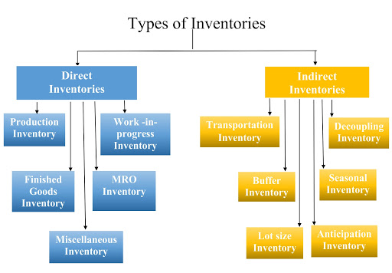
Types of Inventory
Notes:
Direct inventories– they are those inventories which go directly with or within the product. ( USB card which goes along with the mobile phone)
Production Inventories– Those inventories which are required for production purpose. ( IC, PCB, USB etc in a mobile phone)
Work in progress inventories– those inventories or sub assemblies which have crossed the stage of raw material and are getting converted into finished product.( PCB with few components, and connectors inserted )
MRO Inventory – Inventories used for maintenance, repairs, and operations of machinery. ( a blower, a screw driver, a rubber sheets etc used while repairing a mobile)
Miscellaneous inventory – it is self explanatory , items which are miscellaneous in nature. ( tissue paper)
Indirect Inventories – Those products, which do not directly go inside the product but help the product to move in the entire supply chain process.( Packing box, instruction manual)
Transportation Inventory– Vehicles such as trucks, tempo, rickshaws, motor cycles, ships, planes drones etc are used for moving the materials from one to another point are called Transportation Inventory.
Now let me know how many of you feel that material handling equipment's, Conveyors, escalators, elevators, shall not be considered as transport inventories? And the reason with why?
Volunteer student at least 3……..
Decoupling inventory – Safety stock is an classic example of decoupling inventory. This safety stock acts as a buffer when there is sudden rise in demand. It decouples or keeps itself as a buffet from the main stock with the supply –demand function.
Buffer stock– It is stock which protects manufacturer from the customer during abrupt demand change. Safety stock will protect the manufacturer from the change taking place at suppliers end.
Seasonal Inventory – to meet some specific seasonal demand examples would be Holiday packages, Fashion apparels, Entertainment tools, back to school items,
Lot size inventory– The items or products fall in one single lot while delivery is referred as lot size inventory, or to adjust the economic size order quantity. Examples – packet of 6 color pencils, packet of 12 colors of sketch pen, highlighters set of different colors.
Anticipation Inventory – It is a stock created before a peak selling season, or before some promotional event, or before some lock down period, or possibly before a strike, or morcha bandh scenario.

Slide 12
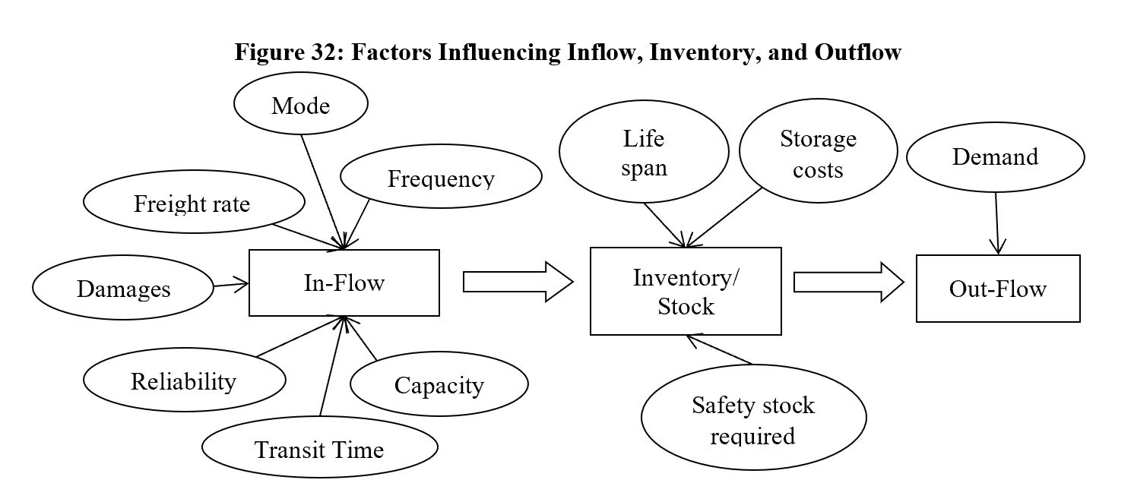
Inventory Control
Factors Influencing Inventory Control
Notes:
When ever we talk about control or rather any control we should first understand what are the factors that will influence the control. So here we will study what are the different aspects that can influence the inventory control.
Before we proceed to I want some body from you to share what controlling activity u are undertaking to restrict the usage of internet data. Please do not tell me how u control your anger, anxiety, emotions etc, we want to discuss some thing which can be measured.
Now I want every one student to read out the point mentioned in the above chart and share his views as how will it affect the inventory control – section wise i.e inflow, inventory stock, and the outflow
--
--
Now students I will read out few factors that influence the inventory control, you should let me know how will it influence?
Now I need 13 students to volunteer for next 13 points
Requirements that are received from Marketing, Production, and sales dept need to be more correct.
Stock levels inside the factory
Quantities ordered – in transit inventories, and inventories available with the supplier
Lead Time/ Procurement time --from date of indent to receipt of material
Design changes due to market demand – leads to obsolescence/scrap
Vendor relationship
Availability of raw material in the market
Changes in the government policies
Annual consumption, changes in consumption pattern
Seasonal demands
Delay in supply
Transportation
Warehousing
Hope u have understood the influencing factors on inventory control. Now let us learn why it very important to have inventory control, or what impact it has on the overall growth of the organization or how does it impact the profitability of the organization? ( next slide )

Slide 13
Methods of Inventory Control
Inventory Control – Methods/ Techniques
Stock Levels.
Economic Order Quantity (EOQ).
ABC analysis.
Perpetual and Periodic Inventory Control
Physical verification

Slide 14
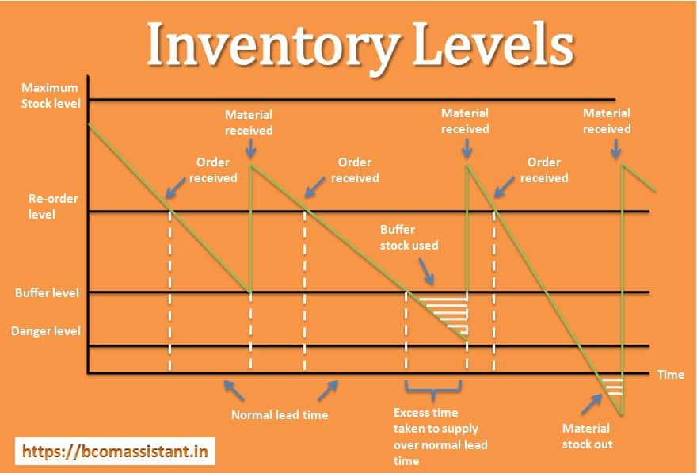
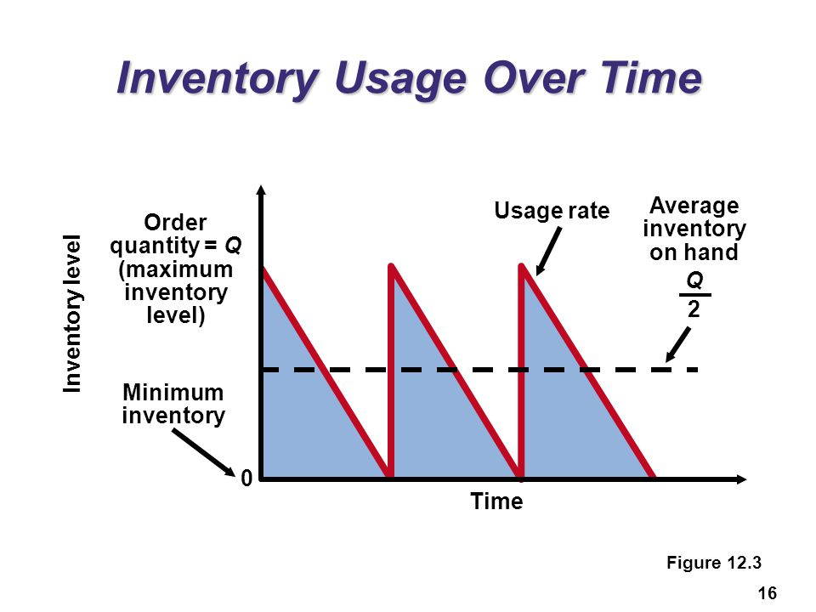
Stock levels – Reorder-Minimum-Maximum-Average-Danger levels
Notes:
Reorder Level (ROL or ROP Reorder Point)– This is the level of inventory at which the order has to be placed. This is the level at which new requirements are placed to purchase the materials. This is the level at which new order is placed and raw material is procured.
Minimum level- This is the level at which stocks shall be maintained at any given time.
Maximum Level - The term is self explanatory. This is the level above which the stocks should not be permitted to rise.
Safety Level – A level at which stocks are maintained to overcome stock out situations. The stock that will probably will not entirely consumed before the stock gets next replenished. Safety stock is used primarily to compensate against the variation in demand.
Danger Level– It is that level of stock below which the alarm gets raises and the stocks gets replenished on first priority.
Activity 3 – identify 3 inventories which u need, list out the reasons why u need , when do u need, how much do u need? Also identify the level
This will help to understand the inventory planning better for yourself as well for the organization.

Slide 15
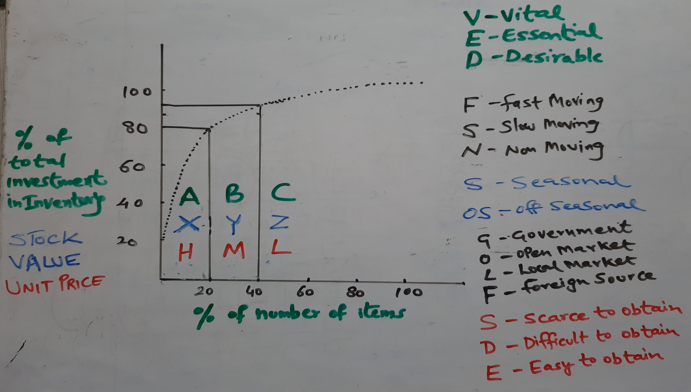
Classification of Inventory
Notes:
Students today I am going to explain you these types of inventories by giving you the examples from industry perspective and not what is given in the books. Because what ever is mentioned in the books you all know. Today by knowing the examples you can learn the classification of these inventories much better.
ABC Analysis – This classification is based on the annual consumption value of the items. It means small number of items account for major portion of investment in inventory. For ex in a construction industry A class items comprises of Steel, Cement, Ready mix concrete which are small in % of number of items ( say between 10 to 20%) but very costly and contribute a major share in investment ( say around 70-80%). These items require major attention. Now C class items includes hardware, binding wire, consumables, adhesives, chemicals, paints, wall putty, bitumen etc approx. 70% of the items account for only 10% of the investment. Remaining are the B class of items consists of Aggregates like crushed sand, stone, granite, plumbing, electrical items etc.
This is based on Pareto Analysis principal developed by Italian Economist Vilfried Pareto.
XYZ Ana;ysis – The method of arriving the classification is same but the only difference here is % no. of items are compared with the stock value.
X stands for high stock value for ex if u consider a hospital then high stock value items would be beds, ventilators, oxygen cylinders, special equipment's, medicines, emergency kits, etc 20% of items contribute to 80% of the stock value & Z stands for least stock value masks, gloves, syringe, office stationary, etc, and the remaining fall in Y class like linen, threads, .
HML – H stands for High price per unit of the item for example if you are heading procurement of a water park resort then high value items would be Boomrang O Slide, or Giant Cyclone water ride, or the infrastructure for wave pool etc, M stands for medium for example the Tots flower shower, or water slider tubes, coaster, etc & L stands for low unit price of the item.
VED –for example for a educational institute items like Class room, teaching aids, projector, screen are essential, whereas Air conditioners, air purifiers are desirable but proper building, library, healthy environment, good ambience are vital
FSN – In aTV manufacturing unit we usually find electronics components, PCB’s i.e. printed circuit boards, LED’s, transformers, heat sinks etc are fast moving items, whereas some components which are exclusively used for customized product fall under slow moving items, and items pertaining to old sets that are not produced now lie idle in the stocks are called as non moving stocks such as themocoles, packing boxes, pvc covers, manuals, remotes of all old models which are not produced now or has been discontinued.
SOS– Items like notebooks, text books, pen, stationary items etc are supplied during specific period of the year. Such items are referred as seasonal inventories. But the same inventories needs to be procured during the off season so at that time they are referred as off season inventories.
GOLF – G stands for Government. Items which are routed through govt agencies, authorities like State Trading Corpn, FCI, Minerals, & Metals Trading Corpn, Coffee Boards etc. Such items require long lead times, and needs huge paper work for approval & procedures. O stands for open market procurement of items. L stands for items procured from local market & F stands for items procured from imports.
SDE – for example the wafers and the solar glass is Scarce to obtain as the world has stopped buying from China as of now. Now we also see many underdeveloped countries are facing shortfall of medical practitioners to treat Covid -19, this again a service which is scarce to hire for those countries. D is for difficult to buy. Now a days there seems little difficulty in hiring or availing the services of parlour, saloons, gymnasium training etc.
Activity for all – against the video of the inventory which you had prepared earlier , now identify and list out the inventories which u feel should fit into the above classification– at least 3 to 5 inventories shall be classified. Take a screen shot of the earlier slide and the present slide for your ref.

Slide 16
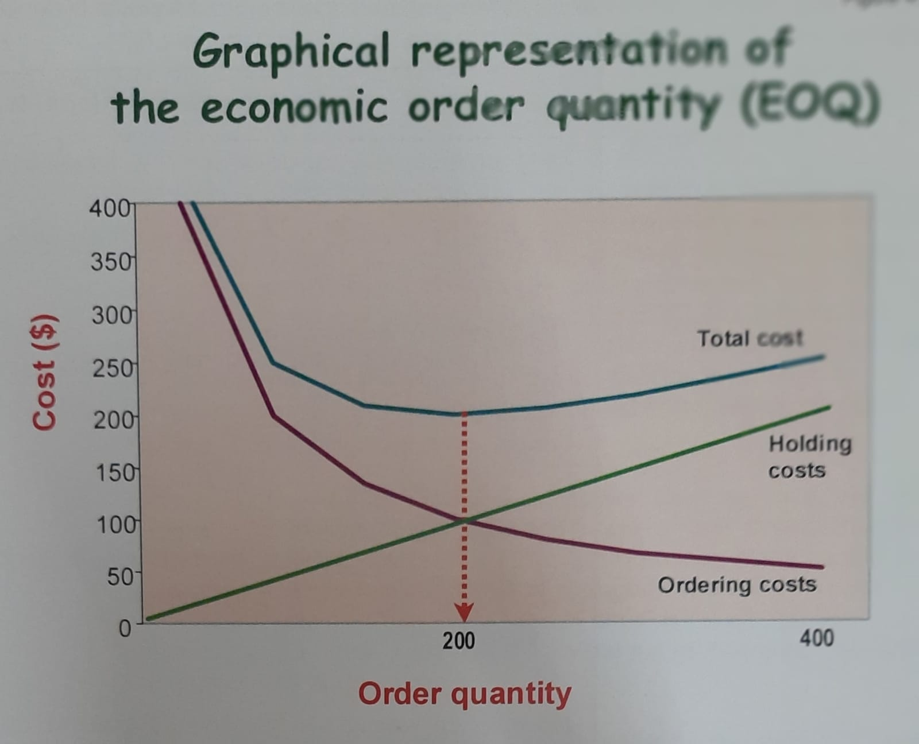
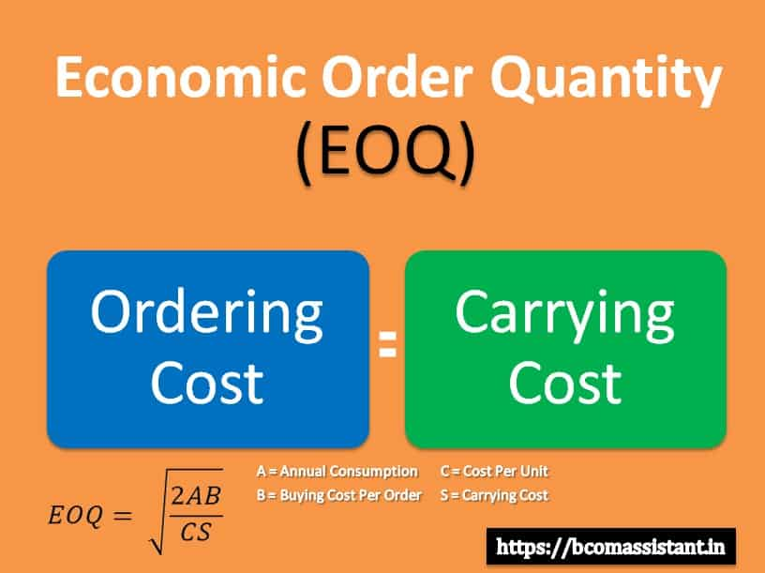
EOQ
Notes:
EOQ– In simple words and practically speaking the EOQ is that qty where the Total cost curve is at its lowest point lowest point. It exactly means that this is the point exactly where the Holding cost curve and the Ordering cost curve intersect each other. It also means these two cost are equal to each other.
Here ideally speaking the Lead time, Transportation cost, demand, order processing cost price etc are considered as constant.
Economic order quantity (EOQ) is the ideal order quantity a company should purchase to minimize inventory costs such as holding costs, shortage costs, and order costs. This production-scheduling model was developed in 1913 by Ford W. Harris and has been refined over time. By definition, Economic Order Quantity is a formula used to calculate inventory stocking levels. Its main purpose is to help a company maintain a consistent inventory level and to reduce costs. EOQ uses variable annual usage amount, order cost and warehouse carrying cost.
The shop owner sells 1,000 shirts each year. It costs the company 5 per year to hold a single shirt in inventory, and the fixed cost to place an order is 2. The EOQ formula is the square root of (2 x 1,000 shirts x 2 order cost) / (5 holding cost), or 28.3 with rounding.

Slide 17
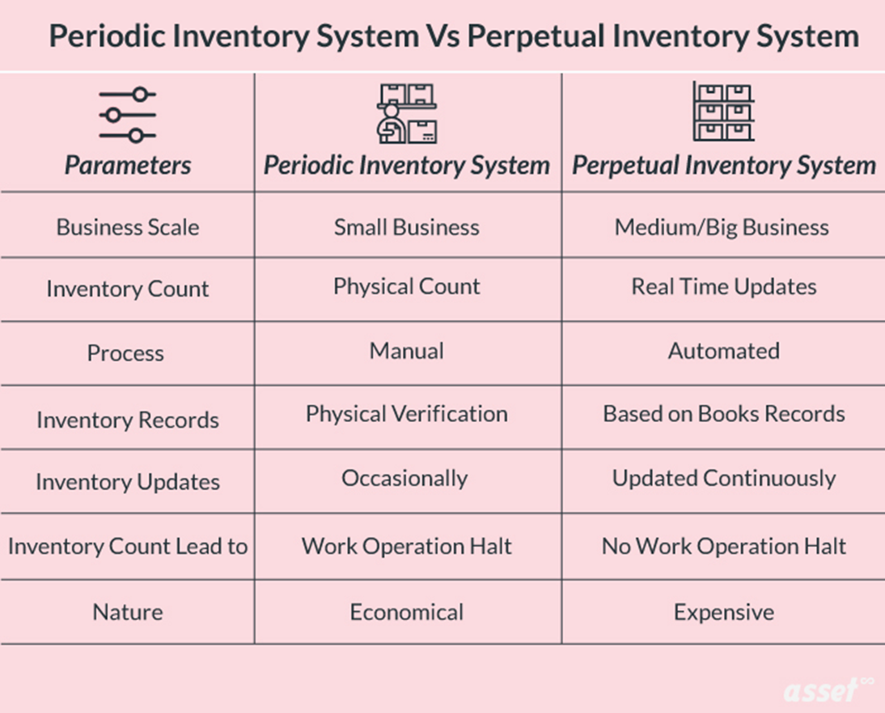
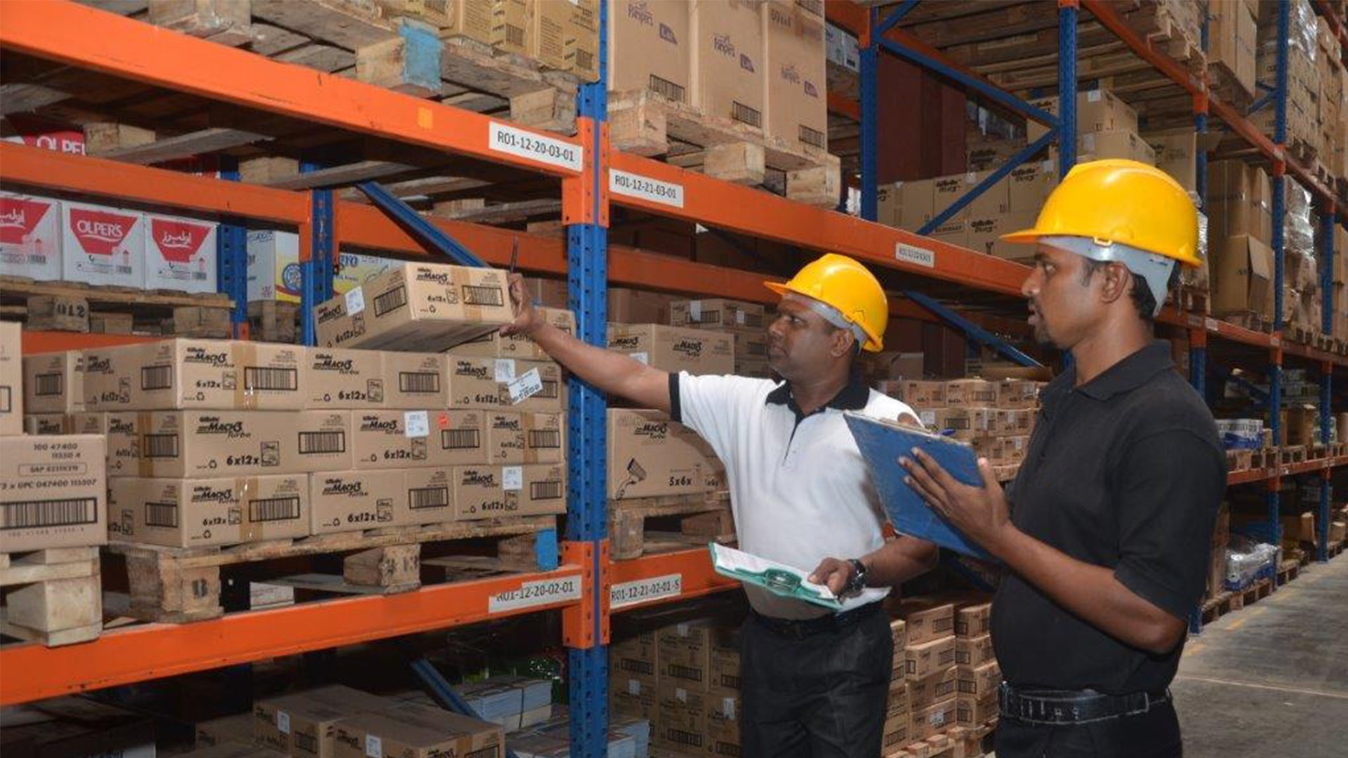
Perpetual & Physical Inventory Control
Notes:
Perpetual = शाश्वत
Almost all businesses need to have some type of inventory management system in place. Of course, some businesses need it more than others. Stores, warehouses, shipping companies, manufacturing facilities, and similar companies need to know exactly what they have on site at all times in order to ensure they can perform their duties.
For these types of businesses, using a perpetual inventory system is a great way to keep track of inventory, ordering, and other related tasks. There are quite a few different options when it comes to this type of inventory system. Learning more about how this type of system works can help management discover which is best for their environment.
Perpetual inventory systems, also known as continuous inventory systems, are systems where the information about the inventory in a facility is updated in near-real time. As an item is bought or used, it will be removed from the inventory system. As new items are brought in, the system will be updated to reflect this as well.
What is Perpetual Inventory?
Perpetual inventory is a form of inventory accounting. It records the sale and/or purchase of goods and assets (inventory) continuously, be absolutely up to date. Perpetual inventory is extremely critical in tracking the real-time movement of inventory. Updates are made immediately as and when a product is sold, or raw materials are processed.
The formula for the same is extremely simple:
Beginning inventory + receipts - shipments = Ending inventory
The concepts behind this kind of inventory system are very simple. Implementing them can be more of a challenge, but even that has become easier thanks to advancements in technology over the years.
What Is a Perpetual Inventory System? A perpetual inventory system is a program that continuously estimates your inventory based on your electronic records, not a physical inventory. This system starts with the baseline from a physical count and updates based on purchases made in and shipments made out.
What is an example of perpetual inventory? With a perpetual inventory, all transactions involving costs of merchandise get recorded immediately as they occur. For instance, take grocery stores - each time a product is bought and scanned, the system updates inventory levels in the database.
What is a perpetual method?
A perpetual inventory system is an inventory management method that records when stock is sold or received in real-time through the use of an inventory management system that automates the process. A perpetual inventory system will record changes in inventory at the time of the transaction.
What is under perpetual inventory?
Under the perpetual inventory system, an entity continually updates its inventory records in real time. ... It is least effective when changes are recorded on inventory cards, since there is a significant chance that entries will not be made, will be made incorrectly, or will not be made in a timely manner.
Using a Perpetual Inventory System
There are many ways that a perpetual system for inventory can be used. Technically, this type of inventory management could be handled using just paper and a pencil. This would only really be feasible on a very small shop, but it could be done by simply writing down everything as it comes and goes.
Most companies will use automated computer systems to run a perpetual inventory system. Advanced systems can scan barcodes or RFiD tags as they come in or out of a facility, and immediately update the inventory system. The software can also incorporate a connection with a cash register, and automatically update the inventory system as people make purchases.
Physical Inventory Control-- What is a physical stock?
Physical stock refers to items that are actually present and available in a business' warehouse.
What is an example of physical inventory?
What is Physical Inventory? Physical inventory is an actual count of the goods in stock. This can involve counting, weighing, and otherwise measuring items, as well as asking third parties for counts of inventory items that have been consigned to them
What is physical stock verification?
Stock Verification is the physical counting of stock. Where counting is not possible, measuring or weighing is done. The results of such physical checking are systematically recorded
Why is physical verification of stock important?
Physical verification is reasonable assurance regarding reconciliation of assets, stock and inventory with mentioned financial statements. It also provides information to all stake holders whether financial statements provide true and fair picture.
What is the difference between physical and perpetual inventory?
Perpetual inventory continuously tracks and records items as they are added to or subtracted from the inventory. And it keeps track of the cost of goods purchased and sold. Physical inventory uses a periodic schedule to manually count and record items and keep track of the cost of what's bought and sold.

Slide 18
Inventory Turn Over Ratio
Notes:
What is Inventory Turnover?
Inventory Turnover is a ratio measuring the number of times that a company has replaced its inventory balance in a specific period.
How to Calculate Inventory Turnover Ratio (Step-by-Step)
The inventory turnover ratio portrays the efficiency at which the inventory of a company is turned into finished goods and sold to customers. In other words, the ratio measures how well a company can convert its inventory purchases into revenue.
The ratio is calculated by dividing the cost of goods sold (COGS) by the average inventory balance for the matching period. Thus, the metric determines how long it takes for a company to sell its entire inventory (and need to place more orders).
The steps for calculating the ratio are the following:
Step 1 → Calculate the average inventory by adding the prior period inventory balance and ending inventory and then dividing by two.
Step 2 → Divide the numerator, the cost of goods sold (COGS) in the corresponding period, by the average inventory as calculated above.
Inventory Turnover Formula
The formula used to calculate a company’s inventory turnover ratio is as follows.
Inventory Turnover Ratio = Cost of Goods Sold (COGS) ÷ Average Inventory
While COGS is pulled from the income statement, the inventory balance comes from the balance sheet.
In effect, a mismatch is created between the numerator and denominator in terms of the time period covered.
Income Statement → The financial performance, such as revenue, costs, and profitability, of a company across two periods.
Balance Sheet → A “snapshot” at a specific point in time of a company’s assets, liabilities and equity.
Comparing a company’s ratio to its industry peer group can provide insights into how effective management is at inventory management.
Some examples of practical diligence questions to ask (or answer) from assessing a company’s inventory management are the following:
Is the company pricing its products at a competitive rate where there is sufficient customer demand?
Does the revenue generated from the sale of proceeds offset the expenses to be profitable?
Have recent purchases referenced historical customer demand patterns?
Which specific products have been selling out quickly and causing lost revenue (and vice versa)?
Are there any specific products that have lost a substantial amount of consumer demand as of late?
How to Interpret Inventory Turnover Ratio (Industry Benchmarks)
Since the turnover ratio represents the number of times that a company clears out its entire inventory balance across a defined period, higher turnover ratios are preferred.
High Turnover Ratio → The company likely experiences strong demand in the market for its products.
Low Turnover Ratio → There might be poor demand in the market and excess inventory accumulating (i.e. overstocking).
The company’s inventory, if left unsold, might eventually need to be written down to reflect the true (lower) value on the balance sheet.
For companies with low turnover ratios, the duration between when the inventory is purchased, produced/manufactured into a finished good, and then sold is more prolonged (i.e. requires more time).
That said, low turnover ratios suggest lackluster demand from customers and the build-up of excess inventory.
Retailers are typically known for exhibiting high turnover ratios – in particular, “fast-fashion” retailers like Zara are highly regarded for their ability to research trends and clear out their inventory quickly.

Slide 19
Physical verification
Notes:
Why Do Materials Require Verification?
All organizations should have a system in place to check and verify stock on a regular basis according to local conditions and requirements. For example, if a company receives a monthly consignment of materials, then it will have to physically verify that all goods have been received by the last day of the month. If the verification is not carried out on time, then any goods received after that date will not be included in the actual quantity of materials on hand.
What Should Be The Basis For Stock Verification?
A physical stock count needs to be completed on a regular basis, usually monthly or quarterly. The physical quantity of stores should be checked against the number of items recorded in the store ledger and order records. A thorough review should also involve checking current stock against the previous year's valuation to ensure that there are no major discrepancies.
Who Should Carry Out Stock Verification?
Verification is usually carried out by a member of the accounting or auditing team, who can review all records and compare them with an actual physical count. The audit department could be used if the company has one in place. If the company does not have an audit department, then a staff member from accounting or purchasing could be asked to carry out stock verification.
What Do We Need To Check While Carrying Out Physical Verification?
The entire process of inventory counting should take place in a well-lit and clean environment that is free of dust and other contaminants. All items should be checked one by one and the count should match with data from records such as invoices, packing slips, delivery dockets, etc.

Slide 20
NITIN ATHAVLE Contact: 9423013272
Email: athnit2@gmail.com Linked In: https://www.linkedin.com/in/nitin-athavle-a0860a47
Notes:
Hope you all have enjoyed the session.
Thank You.

