Slide 1
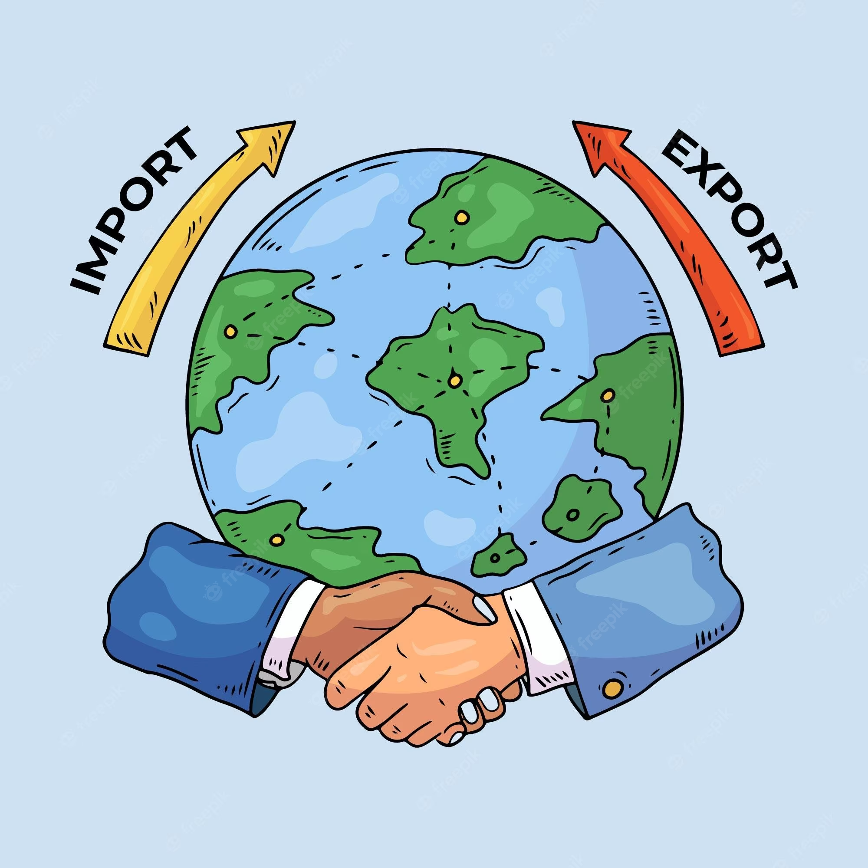
Export & Import
Overview of key components
India exports approximately 7500 commodities to about 190 countries, and imports around 6000 commodities from 140 countries

Slide 2
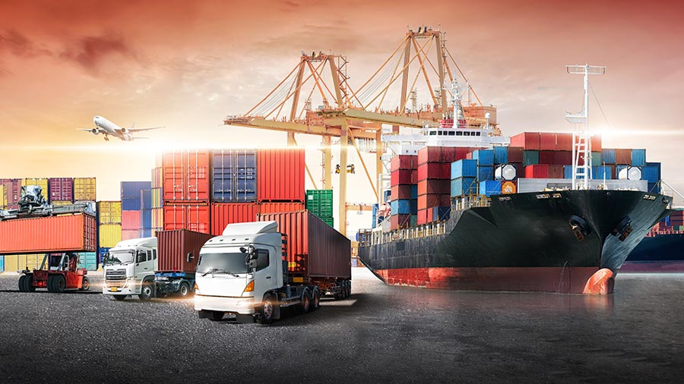
Acquirements?
1) Meaning & Definition of EXPORTS & IMPORTS -
ITC Classification of Exports
Categories of Exporters
2) India’s contribution in Imports and Exports
India's major IMPORTS
India's major IMPORTS
India's Global share in Exports and Imports
3) Export proceeds-
L/C Types
L/C procedure for payment
4) Trade Deficits & BOP
5) Port activities

Slide 3
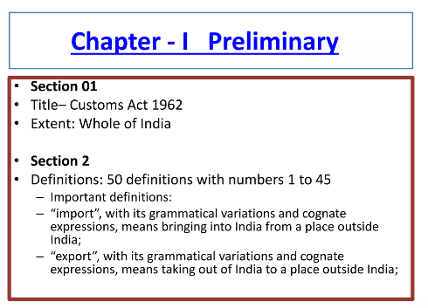
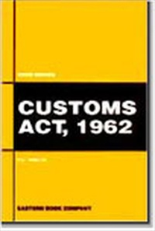

Imports?
Meaning & Definition of IMPORTS -
“means bringing into India from a place outside India”
Imports of goods (P71) consist of transactions in goods (purchases, barter, and gifts) from non-residents to residents. Imports of goods occur when economic ownership of goods changes between residents and non-residents.
“any goods which are imported or attempted to be imported”
“An import is a good or service bought in one country that was produced in another”.
“to bring in products, goods, etc. from another country for sale or use”
“importing refers to the purchase of foreign products and bringing them into one's home country”.

Slide 4
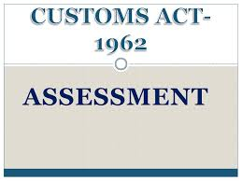
Exports?
Meaning & Definition of EXPORTS -
“(Section 2(18)) of the Customs Act 1962) taking goods out of India to a place outside India .”
“Goods and services produced in one country but supplied to buyers in another”.
“Goods and services manufactured in one country and acquired by citizens of another country”
“Section 75 of the Customs Act covers the cases where any goods are being exported ”.
“exports are goods that a country sells to another”
“goods or services manufactured in one country and sent to another to be sold to purchasers”.
“the practice of producing a good or service in one country and selling it to consumers in another country”.

Slide 5
Classification of Goods?
A. Prohibited Goods The prohibited items are not permitted to be imported. An export license will not be given in the normal course for goods in the prohibited category, except where the import is for Scientific & research purpose or zoo exchange between government to government owned zoo or bonafide personal use house hold effects for which supportive documents are presented as prescribed under the law.
B. Restricted Goods The restricted items can be permitted for import under license. The procedures / conditionality’s wherever specified against the restricted items may be required to be complied with, in addition to the general requirement of license in all cases of restricted items. For example if live animal is restricted than permission from Chief Wild Life Warden of concerned state has to be obtained and license from DGFT needs to be obtained on the basis of recommendation from Wild Life division, Ministry of Environment, Forests & Climate Change and also if it is in CITES than permit from country of origin required to be produced.
C. Free Goods listed as “Free” in the import Licensing Schedule may also be imported without an import license as such but they are subject to conditions laid out against the respective entry. The fulfillment of these conditions can be checked by authorized officers in the course of import. The free importability is however subject to any other law for the time being in force.

Slide 6
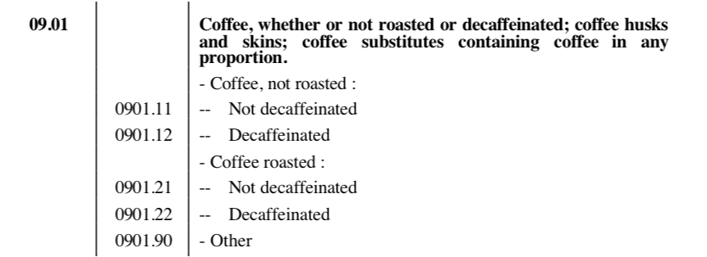
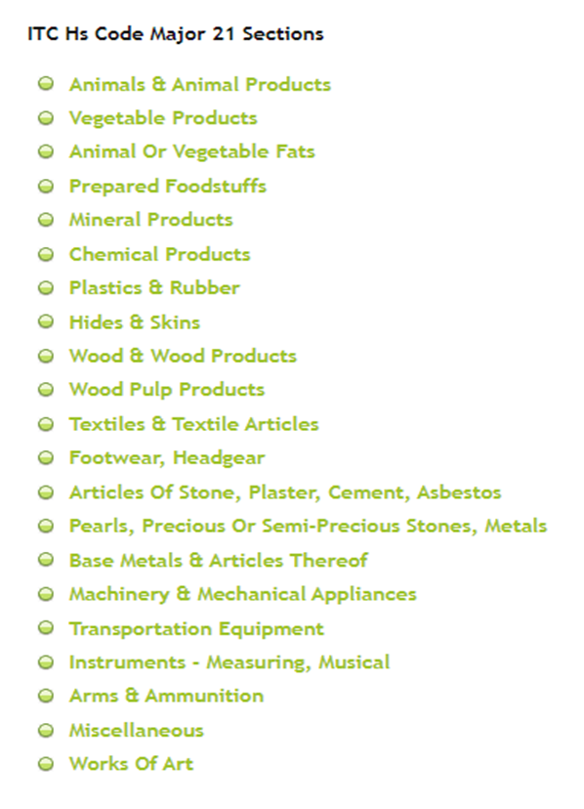
ITC of Imports & Exports?
ITC-HS Codes or better known as Indian Trade Clarification based on Harmonized System of Coding was adopted in India for import-export operations. Indian custom uses an eight digit ITC-HS Codes to suit the national trade requirements.
ITC has been classified as first four-digit code called 'heading' and every six digit code called 'subheading' and 8-digit code called 'Tariff Item'. This addition is done, within the permissible limit of World Customs Organization – WCO, without any changes in H.S. code system.

Slide 7
Types of Exporter?
(a) Manufacturer Exporters: Manufacturer exporters are the manufacturers who export goods directly to foreign buyers without any intervention from intermediaries
(b) Merchant Exporters: Merchant exporters are the exporters who purchase goods from the domestic market and sell them in foreign countries
(c) Status Holders: The Government of India introduced the concept of status holders in the in the year 1960. Export House (EH) was the first category introduced by the Government with the objective of promoting exports by providing assistance for building marketing infrastructure and expertise required for export promotion.

Slide 8
Types of Exporter?
(d) Service Export House: Considering the increasing share of services in the total export from India, the government introduced the concept of Service Export House in the EXIM policy 2002-07. As per this policy, the service providers who have achieved a stipulated level of export performance are eligible for recognition of status holder. Accordingly they are eligible for all the facilities and incentives, hitherto given to the export and trading houses. These facilities include import of capital goods under EPCG scheme, passenger baggage, import of restricted items, etc. The above categorisation also applies to the service providers.
(e) Canalising Agencies: Canalisation of import and export means import and export of commodities through specified government agencies such as State Trading Corporation of India (STC), Metals and Minerals Corporation (MMTC). The items specified in the canalised list can be canalised only through specified canalising agency.
(f) Export Consortia: In this case, a number of economically independent manufacturers, voluntarily or under the direction of the government, set up a joint organisation for co-ordination of their export activities. This has several advantages, such as;
Price stabilisation;
Saves unproductive expenditures such as advertising;
Economies of scale.

Slide 9
Economic Complexity Index
These economic complexity rankings use 6 digit exports classified according to the HS96 classification. We consider only countries with population of at least 1 million and exports of at least $1 billion, and products with world trade over $500 million.

Slide 10
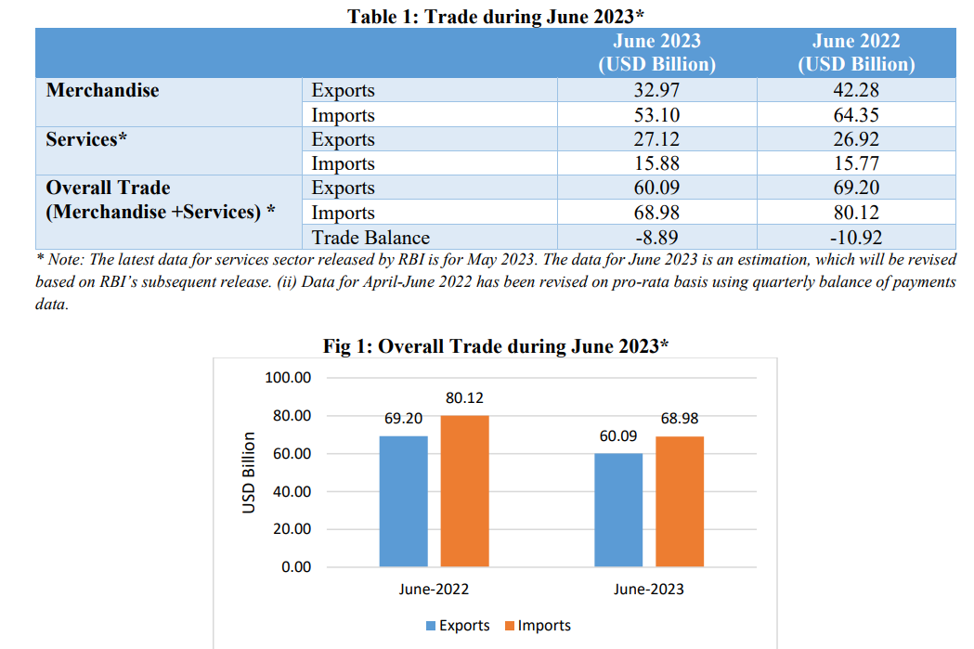
India’s Major Imports and Exports

Slide 11
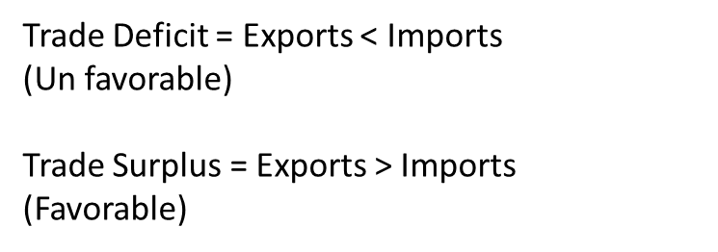
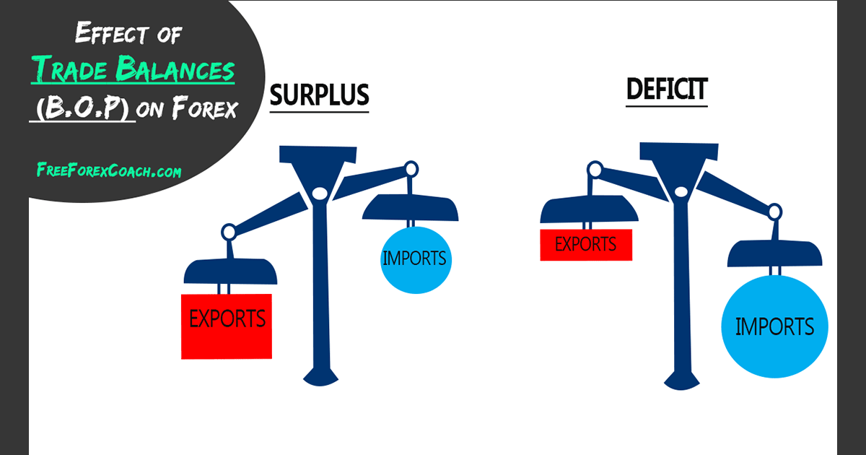
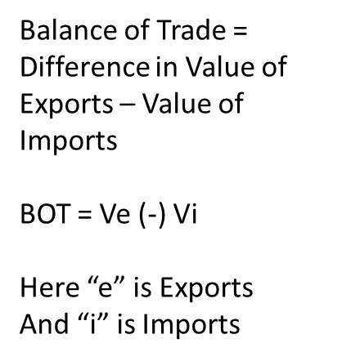
Balance of Trade
Trade Balance
International Trade Balance
Commercial Balance

Slide 12
Balance of Payment
Balance of International Payment
BOP = Difference in Inflow of Foreign Exchange (-) Outflow of Foreign Exchange
B = R – P
B is Balance
R is Receipts
P is Payment
BOP = All money entering (-) all money exiting
Balance of Payment = Current Account (-) Capital Account
Current Account is Exports and Imports both, as well it has
Net Trade in Goods & Services
Net Earnings on cross border investment
Net Transfer payment
I + G + X = S + T + M
Here X – M = (S-I) + (T-G)
If budget is balanced then
T-G=0
S-I =0
So it will follow X-M=0
Capital Accounts has all National Transactions in the financial instruments

Slide 13
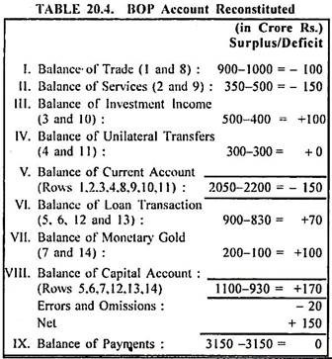
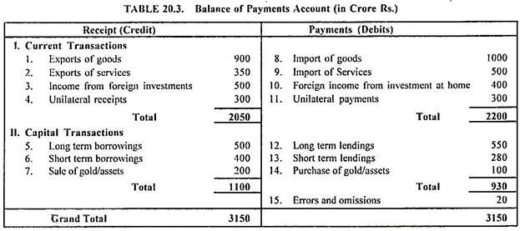
Balance of Payment
Balance of International Payment
BOP = Difference in Inflow of Foreign Exchange (-) Outflow of Foreign Exchange
B = R – P
B is Balance
R is Receipts
P is Payment
BOP = All money entering (-) all money exiting
Balance of Payment = Current Account (-) Capital Account
Current Account is Exports and Imports both, as well it has
Net Trade in Goods & Services
Net Earnings on cross border investment
Net Transfer payment
Capital Accounts has all National Transactions in the financial instruments

