Slide 1

Navigating Success
Unlocking lucrative career paths in Operations and Supply Chain Management

Slide 2
Outline of the session
Introduction to Operations Management
Introduction to Supply Chain Management
Job opportunities in Specialized fields of Operations
Job opportunities in Specialized fields of Supply Chain
Required skill sets / abilities for specialized fields
Required skill sets / abilities for specialized fields
Q & A

Slide 3
Introduction to Operations Management
Production or manufacturing – RM FG
Production of Goods and Services both
Process- Planning, executing, monitoring, delivering
Core of PM– Project evaluation wr.t. Time, Cost, Goal
Functions – Designing, Conversion, Flow, efficiency, Quality, Delivery, profitability, balancing cost with revenue
Key elements – Strategy, forecasting, scheduling, MM, Infrastructure, PM/Tools/Equipment’s, Workforce, quality management, Men, material, machines, Money, Measurements, management
Role- Planning, organizing, staffing, directing and controlling

Slide 4
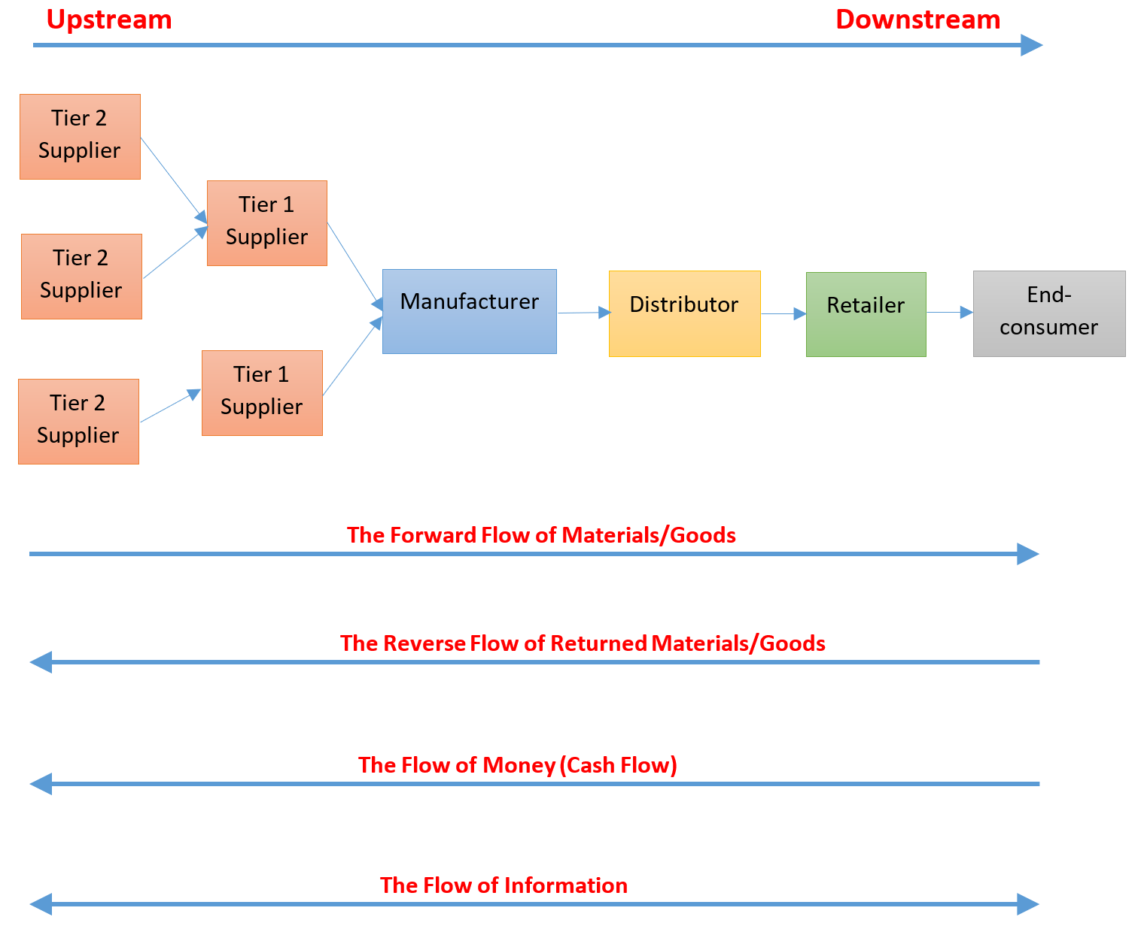
Introduction to Supply Chain Management
Elements – Planning, sourcing, making, physical distribution, returns management
Process- Strategic planning, Demand Forecasting, designing, purchasing, manufacturing, warehousing, transportation, delivery of goods
Objectives – Smooth flow of goods-finance & information, efficient Inventory management, reduction in costs, improving quality in product, people, process, systems and adding value, timely delivery, customer order fulfillment, T/T/V
Areas of Specialization- Purchasing, Inventory Management, Material handling, packaging, labelling, picking and storing, kitting, checking and counting, documentation and entry, record keeping, dispatching, real time updating with systems
Success lies in – People, Process, systems, information, technologies, quality, INTEGRATION

Slide 5
Job Opportunities – specialized fields of Operations

Slide 6





Skill sets / Abilities required or to be acquired
Block Chain
Artificial Intelligence
Data Base Management, Networking, Encryption, Tokenization, Data Structuring
Prototype Developing, Programing, Data Science, BI, NLP, Problem Solving, Creativity, Python
Skill set / Abilities
Integration
IOT
Systems, Software, hardware, platform, networking, Internet, extranet, intranet.
HW+Sw Networking, User Interface Modelling, Community Networking, Connectivity Expansion, Platform Management, Application Enablement
Robotics
Cloud
System thinking, Critical Thinking, Problem Solving, Testing, Conversational Integration, Decision making, Arm Data Specialization.
Programing, Analytical thinking, Cloud Security, Automation, LINUX, Application Loading, Application Testing, Hybrid Storage
A

Slide 7
Job Opportunities – Generalized fields of Operations

Slide 8
Managerial Skills required

Slide 9
Customize your CV

Slide 10
